Slide 1

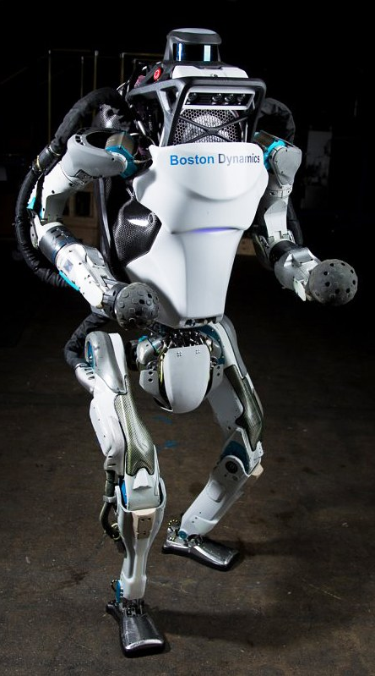
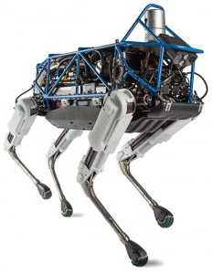
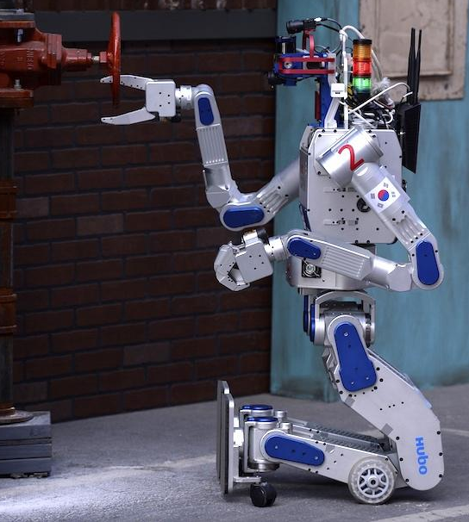
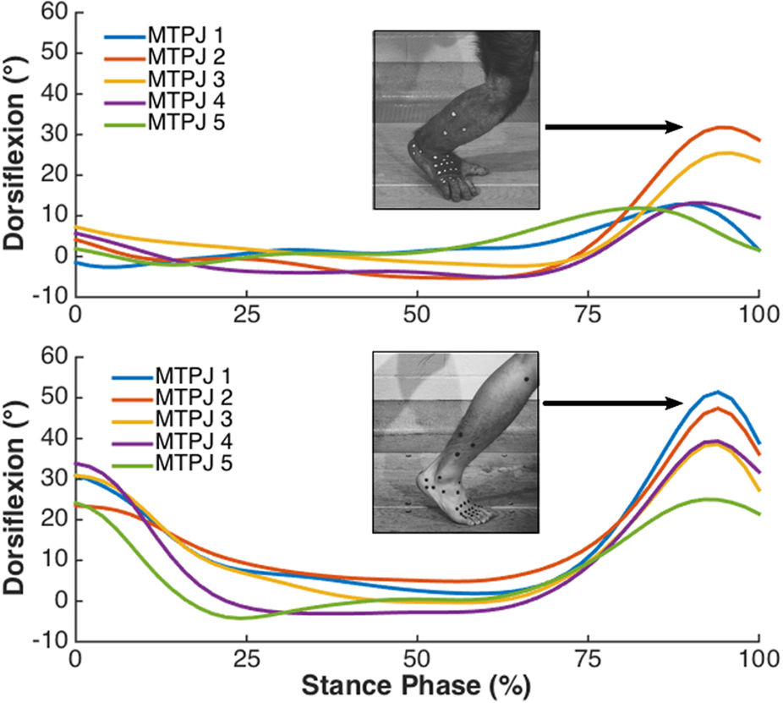
ROS2
Part I
Open Milestones.
Further discussion required
Description. (font: Lato, 10, bold, black)
Locomotion
Approach. (font: Lato, 10, bold, black)
Complete Course on Locomotion and Planning
  Refer to Irvin’s Research Doc
Research the following
  Controls
  Mechanical Designs
  Software Designs
  Software tools and resources
Date
Tentative
Milestones.
2018-04-02 1

Slide 2
Summary
Accomplishments.
Completed half of Locomotion and Robotics Course on EDX
Research outlined doc
Path forward.
Cover underactuated robotic more in depth
Defined mechanical design of robot
Assess software tools and packages
Discuss further research
Footnotes.
Boston Dynamics has publicly proven that their humanoids can robustly achieve the tasks of the DRC. But they’ve yet publish or disclose any academic material on their technology
Irvin’s Video of the Week.
Comments: Didn’t we build this before??? We need to discuss PR strategy. See other videos in YouTube Channel
https://www.youtube.com/watch?time_continue=64&v=ux10tNwYtqk
2018-04-02 2

